Slide 1

An Autonomous Institute
Affiliated to VTU, Belagavi, Approved by AICTE, New Delhi,
Recognized by UGC with 2(f) & 12(B), Accredited by NBA & NAAC
DEPARTMENT OF ELECTRICAL AND ELECTRONICS ENGINEERING
5
SUBJECT NAME: ELECTRICAL AND ELECTRONICS MEASUREMENTS
LECTURE PRESENTATION MODULE – 5
Group Members:
1. Chetan C (1MJ19EE006)
2. Shruthi K (1MJ19EE032)
3. Sumanth M (1MJ20EE404)
4. Vinay KS (1MJ18EE039)
Guided By: Mrs Gayathri R

Slide 2
TITLE
Development And Implementation Of Cloud Platform For IoT Devices

Slide 3
Contents
Introduction
Objectives
Motivation
Methodology (Block Diagram)
Software Requirements
Requirements
Work Done
Reference Papers

Slide 4
Introduction
Internet of Things (IoT) platform is a software system designed to connect and manage internet-enabled devices and sensors, collect and analyze data, and automate actions based on the insights gained from that data.
The IoT platform serves as the backbone of the IoT ecosystem, enabling the communication and interoperability of various devices and applications.
It possible to create intelligent and connected systems that can optimize operations, enhance user experiences, and drive innovation across various industries.

Slide 5
Objective
Connecting devices and sensors to enable real-time data collection and analysis.
Providing a platform for data management, storage, and analytics.
Enabling automation and decision-making based on insights gained from data analysis
Enhancing operational efficiency, productivity, and cost savings.

Slide 6
MOTIVATION
IoT has enabled the creation of intelligent and connected systems that can transform industries and improve the quality of life for people around the world.
IoT platforms are motivated by a range of factors that include improving efficiency, reducing costs,
Enhancing the user experience, promoting innovation, improving sustainability, enhancing safety and security, and improving decision-making.

Slide 7
Methodology
Cloud
Web Application
AC Supply
230 Volts
Host
Relay
Bulb
Micrcontroller(Nodemcu)
Block Diagram

Slide 8
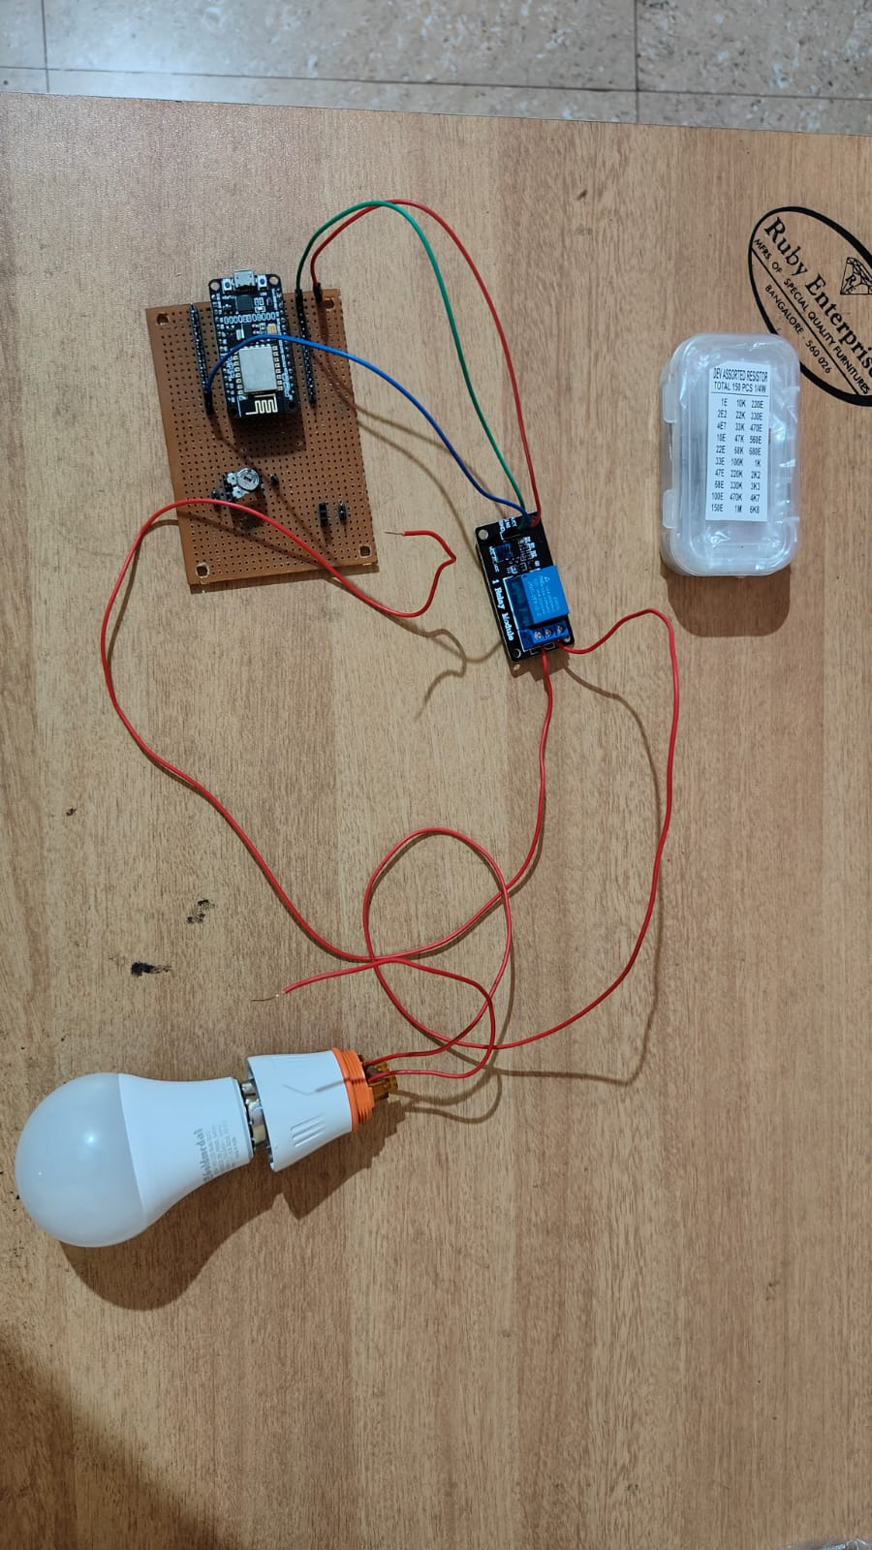
REQUIREMENTS

Slide 9
SOFTWARE REQUIREMENTS
Django
Html
Css
Javascript
Tools / IDE’s used
Visual studio code

Slide 10
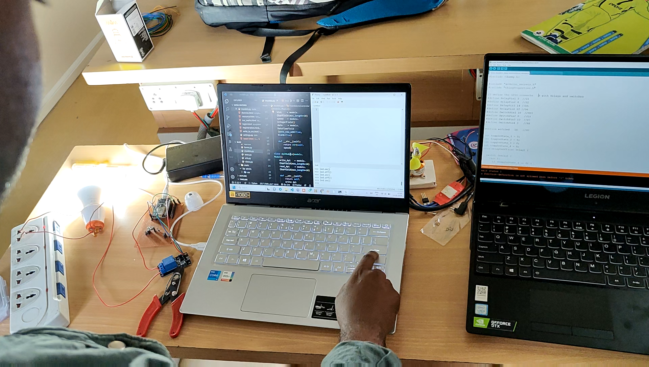
WORKING MODEL OF THE PROJECT

Slide 11
work DONE
Sl. No. | Work to be Completed | Target Dates
1 | Literature Survey | 26/11/2022
2 | Selection of Front-End design | 30/11/2022
3 | Setting-up authentication | 01/12/2022
4 | Submission of 1st chapter report | 03/12/2022
5 | Completion of Front-End design | 12/12/2022
6 | Microcontroller programming | 19/12/2022
7 | Completion of server-side programming | 24/12/2022
8 | Debugging and troubleshooting of errors | 26/12/2022
9 | Submission of 2nd chapter report | 28/12/2022

Slide 12
WORK DONE
Sl. No. | Work to be Completed | Target Dates
10 | Integrating of hardware and software | 13/02/2023
11 | Trail and error analysis of the project | 27/02/2023
12 | Final test on the project | 31/02/2023
13 | Concluding the results | 10/04/2023
14 | Completion of Hardware | 25/04/2023
15 | Debugging Code | 27/04 /2023
16 | Submission of Draft conference paper submission | 10/05/2023
17 | Submission of final Conference paper | 23/05/2023
18 | Submission of final product | 25/05/2023

Slide 13
Reference Papers
1. ”Internet of Things: A Survey on Platforms and Applications" by Zanella, Andrea, et al. This paper provides a comprehensive survey of IoT platforms and applications, including an analysis of their features, architectures, and use cases.
2."A Survey of IoT Cloud Platforms" by M. Noura, et al. This paper reviews different IoT cloud platforms and evaluates their features and functionalities. It also discusses the challenges and opportunities of using IoT cloud platforms.
3. "Evaluation of IoT Platform Architectures: A Case Study" by M. A. Razzaque, et al. This paper presents a case study of evaluating different IoT platform architectures, including their features and performance.

Slide 14
Reference Papers
4. An IoT Platform for Smart Homes: Design, Implementation, and Evaluation" by Y. K. Chan, et al. This paper presents the design, implementation, and evaluation of an IoT platform for smart homes, including a discussion of its architecture, features, and user interface.
5. "Towards a Reference Architecture for the Internet of Things" by R. Roman, et al. This paper proposes a reference architecture for IoT platforms, including a detailed analysis of the various layers and components that make up the architecture.
6. "IoT Platforms: A Review and Future Directions" by S. S. Chaudhary, et al. This paper provides a review of IoT platforms and discusses their future directions, including challenges and opportunities for research and development.

Slide 15
MVJ College of Engineering
Near ITPB, Whitefield
Bangalore-560 067
Thank You

